Slide 1

Securing Your API Endpoints A practical guide to API authentication
@spetryjohnson

Slide 2

My rookie mistake
Notes:
I have a confession to make. Two years ago, I made a huge rookie mistake.
My team develops a fairly standard web app with session state and server rendered HTML. We eventually want to build a mobile app…
RESTful APIs are normally stateless…. Need authentication.
Anyone here ever google “how to authenticate an API”? I did and found a pretty confusing mess:
Bearer tokens, nonces, federated identity
Correct cryptographic hash function when signing requests
Two different versions of this thing called Oauth
There was no “guide to choosing the right authentication for you”
So… I did a bad thing. In a hurry, rolled my own, got it wrong and shipped a security defect.

Slide 3
Today’s goal: No more rookie mistakes!
Notes:
My goal today is to give you the coherent overview I desperately needed back then.
I’m going to break down all of the complex terminology and compare and contrast the techniques you can choose from.
Next time that you need to choose how to secure an API endpoint, I want you to start from a place of knowledge so that you can make an educated decision and not a rookie mistake.

Slide 4
What’s on the agenda?
Identity vs Authentication vs Authorization
Compare/contrast security techniques
Finding the best one for YOU
Notes:
Here’s the basic structure of this talk.
First, we’re going to talk about three different concepts that you, as an API author, should be thinking about when choosing an authentication solution.
Then we’ll use those concepts to compare and contrast all of the techniques you can choose from when authenticating your API calls. We’ll cover everything from HTTP Basic Auth to OpenID Connect.
Finally, we’ll wrap up with some suggestions for selecting a technology to match your use case.

Slide 5
This is not an advanced security session!
Notes:
Also, I want to be clear about what this session is NOT.
First, I am not a security expert and this is not an advanced security session. If you already know the difference between OAuth 1 and 2 and which authentication options require secure connections and which don’t, or if you already know how to sign a request using HMAC, then you’re probably in the wrong place. My intended audience is people who DON’T know those things, or even that those are the things they need to know about in the first place.

Slide 6
This is not “getting started with <foo>”
Notes:
Second, this is not a “getting started with foo” style talk. In fact, there are things in this talk that I have no direct hands on experience with. I’ve never written any oAuth code myself, so I couldn’t tell you how to get started even if I wanted to.

Slide 7
This is “understand your options”
Notes:
However, I have done a lot of research about OAuth and how it compares to the other options, and that’s what this session is about.
I’ve packaged up all of that research and distilled it into the most coherent format I could create. I want to help you narrow the universe of possibilities to the one or two technologies that are most suitable for your use case.
I’m about to turn on the firehose, and if I go too fast please feel free to stop me and ask questions. This presentation, along with all of my speaker notes, is on my public Github if you want to refer to it later. I’ll give you a link at the end.

Slide 8
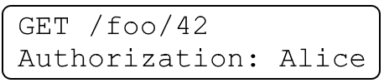
Identity / Authentication / Authorization
Identity: user data
Authentication: which user is this request for?
Authorization: is this request permitted?
Notes:
Subtitle is “A practical guide to API authentication” but actually talk about three different concepts: “identity”, “authentication”, and “authorization”.
Related but different – need to consider separately when making security decision.
Identity is your app’s concept of a user (Alice)
Authentication is process through which we securely associate identity w/ request (is it really Alice?)
Authorization is process through which we validate IDENTITY’s PERMISSION to perform
Just because a request is authenticated doesn’t mean its authorized, and just because a request is authorized doesn’t mean its authenticated. We’ll talk about that when we get to oAuth

Slide 9
Identity / Authentication / Authorization
Not all APIs care about all 3 things
Access control often your app’s responsibility
Notes:
Not all APIs care about all of these things.
Google API key for IDENTITY = rate limiting
Twitter cares about all 3
Point is that before you can pick an authentication strategy, you need to understand what problems it needs to solve.
Lastly, no matter how you authenticate, your app will still be responsible for some amount of access control.
Your custom business rules are the only thing that can know for sure if Alice is allowed to view data for Foo #42.

Slide 10
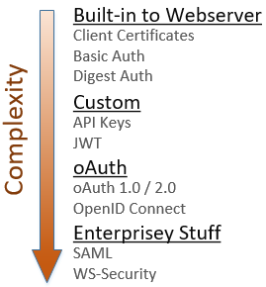
Notes:
So, how do you authenticate and secure your API endpoints? Here are the things I’ll be discussing today:
* Standards-based things directly supported by your web server, require very little code
* Custom implementations require more code, provide more flexibility
* Different flavors of oAuth
* Some very enterprisey things that I won’t get into in detail, but you should at least know that they exist
Again, this session is not a tutorial on how to actually implement any of these. I just want you to understand at a high level how each of these things works.

Slide 11
SSL is broken! Use TLS
Notes:
Real quick sidebar: I assume that everyone here understands the idea of a secure connection in which the communications between a client and server are encrypted. Some of the techniques I’ll discuss require a secure connection, some don’t.
The important thing to note is that SSL is a broken system, it’s not secure. Make sure your servers are set up to use TLS instead.
If I say SSL any other time during this session, it’s just an old habit. I mean TLS.

Slide 12
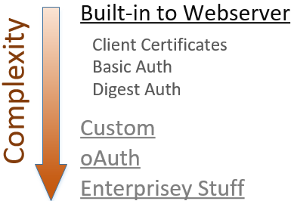
Notes:
The simplest way to secure your API is to use the authentication features built directly into your web server platform.
These 3 solutions are standards-based, are supported by all major web servers, and using them generally requires very little custom code. If you need something quick and dirty, start here.

Slide 13
Client certificates
“Reverse TLS” – proves client identity to server
No usernames or passwords
Ideal for internal apps, not public facing
On IIS, only “simple” w/ Active Directory
Notes:
The 1st of those techniques is “client certificates” = “reverse TLS”. In TLS, cert on server proves identity to client.
Client certs do the same thing, but in reverse. You install the certificate on your browser, and it proves your identity to the server
No login screens, no redirects, every request instantly authenticated.
Drawbacks:
1) all users have to install security certs. Doesn’t scale.
2) In Windows land, this is only “simple” when using Active Direct
These drawbacks mean that client certs are best suited for internal APIs on a secure network
http://www.networkworld.com/article/2226498/infrastructure-management/simply-put-how-does-certificate-based-authentication-work.html

Slide 14

HTTP Basic Authentication
Notes:
If you don’t want to deal with client certs, the next simplest approach is HTTP Basic Authentication.
* Internet standard, supported by all major browsers, easy
* Username and password are Base64 encoded and sent with each request as a header
* Server decodes them and authenticates request
The “Authorization” header is named poorly. Authentication, not authorization.
http://www.asp.net/web-api/overview/security/basic-authentication

Slide 15
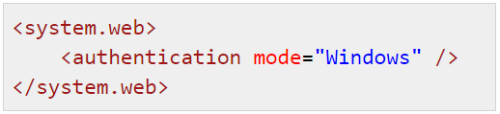
HTTP Basic Authentication
Active Directory supported “out of the box” on IIS
Easily authenticate against custom database (ASP.NET, WebAPI, OWIN)
Notes:
Setting up Basic Auth is really easy. If you’re using IIS, you get authentication against a Windows domain “for free” with a simple web.config setting.
For a public-facing website you’d probably want to authenticate against your custom membership system. In ASP.NET or WebAPI you can do that by writing some simple middleware and overriding a few methods.

Slide 16
HTTP Basic Authentication - drawbacks
Revoking access requires password change
Credentials passed as clear text – requires TLS
Notes:
Basic Auth is very easy, but has two main drawbacks:
1) API client has access to the primary account password
Only way to revoke access to that client is to change the account password
Impacts ALL clients using those same credentials
2) Credentials passed on every request & in the clear.
Remember that Base64 encoding is reversible
Use TLS on every secured request, because TLS encrypts the request as it travels over the wire
Only as secure as the TLS implementation

Slide 17
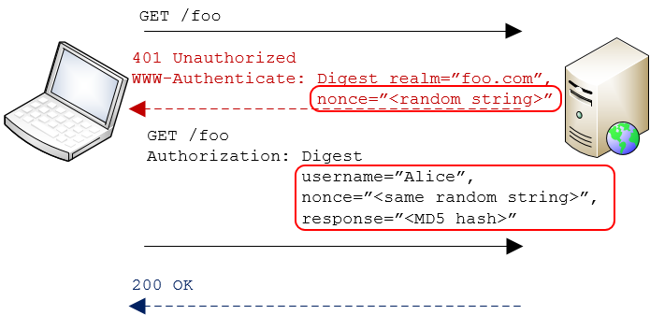
HTTP Digest Authentication
Notes:
An alternative to Basic Auth is another standard called Digest Auth
Main difference is that with Digest, the password is never sent over the wire, so there’s less risk of it being compromised.
Clients makes a secured request
Server responds “not authorized” & includes a “nonce”
Client combines the username, PW and nonce and then creates MD5 hash
Client resubmits request, passing username, nonce, and hash
Server looks up user’s password, re-calculates the hash, compares it to what client sent
Only way hashes match is if client and server used same password to calc hash == proof of identity

Slide 18
HTTP Digest Authentication
TLS not required
Easily integrates w/ other standards-based systems
Prevents storing passwords with strong encryption!
Notes:
Since password is never sent over wire, TLS not required
Just like with Basic Auth it’s very easy to integrate with systems that support the standard.
The main issue is that Digest prevents use of strong password encryption in your user database.
* Must have access to raw password to verify hash.
* 1-way encryption or salt+hash defeats Digest
No one really uses Digest Auth, but it’s important to understand the concept because we’ll see it again later.
http://unixpapa.com/auth/basic.html

Slide 19
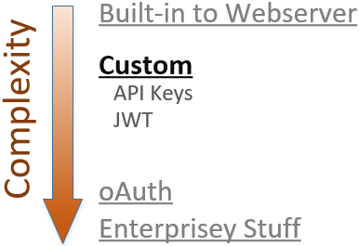
Notes:
Those 3 things work great if you want the API client to present actual user credentials during authentication, and if you’re OK with the constraints those techniques include. But what if those constraints are too limiting?
If you need more flexibility, either in terms of what information you use to authenticate OR how that information is transmitted, then the next simplest approach is to implement a custom scheme using API Keys or JSON Web Tokens.

Slide 20
API Keys
Used in place of username/password combo
Revocable
Usually a GUID – hard to brute force
Use like a password or to “sign” a request
Notes:
Let’s talk about API keys first.
The idea is that the client sends something other than the primary username/combo during authentication.
Keeps primary credentials secure and also allows access to be easily revoked. (Twitter example)
There's no standard - You’re replacing two pieces of info with one, so it needs to be hard to brute force like a GUID
There are two different ways to use API keys for authentication: as a type of password, or to sign a request.

Slide 21


API Keys as passwords (“bearer tokens“)
Via querystring (using TLS)
Via header (using TLS)
Notes:
Simplest way to use API keys is to treat them like a password & pass with each request, like we saw with Basic Auth
You can pass the API Key in either the querystring or an HTTP header.
Querystring really easy to do - ideal for scripting scenarios.
Generally headers are better
Header is more secure – not in log files. Wouldn't want plain-text passwords to be stored in unencrypted log files
Header can’t be leaked via copy/pasting a URL out of Fiddler or the browser's URL bar.

Slide 22
API Keys as passwords (“bearer tokens“)
Anyone that has the key, gets access
Only as secure as the TLS implementation
Should salt and hash keys for storage
Notes:
Using keys like this makes them “bearer tokens”, which is basically a password. Whomever possesses the token may use it for authentication
The token is passed in plain text so you MUST use TLS on all requests, to the token safe in transit and to guarantee message integrity. Only as secure as TLS impl
SHOULD encrypt API keys in your database, just like passwords.
If store as text, and DB is compromised, users get impersonated
Can’t show users a list of their keys. AWS and Octopus Deploy let you associate human readable name

Slide 23
API Keys as cryptographic keys: HMAC
Like Digest Authentication
Notes:
The other way to use API Keys is to use them as a cryptographic key, and digitally sign the HTTP request.
Just like w/ Digest, idea behind “signing” request is that two parties both know a secret value & can communicate securely w/out transmitting secret over wire.
The sender creates a message and uses the secret value to create a hash. It sends the message and the hash to the recipient, which then uses its own secret value to recompute the hash and verify the message.

Slide 24
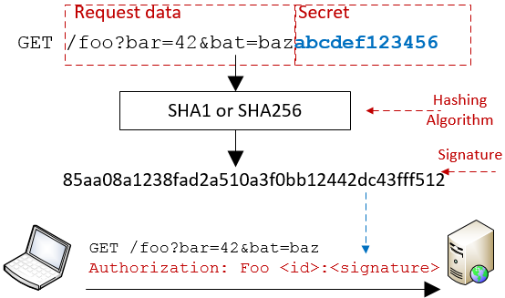
Notes:
Here’s how it works:
The client prepares its message, which in our case is probably a URL like http://foo.com/bar?bat=42
The client concatenates the secret value with that message and then runs it through a hashing algorithm to generate a signature
The client sends the original message to the server, plus the signature in an authorization header.
The server receives the message and repeats the same hashing operation, then compares the result with the value from the authorization header. If they match, it knows the message was created by someone that knows the secret value AND that the message wasn’t modified in transit. (If either of those things is false, the server would have computed a different hash)
Technically speaking the authorization header is a type of “message authentication code”, or MAC. Since this technique uses a hash it’s called a “hash-based message authentication code”, or HMAC.

Slide 25
API Keys as cryptographic keys: HMAC
Signed requests == sensitive values not transmitted
Server ensured of message authenticity
Does not require TLS to keep secret safe
Notes:
HMAC has a lot of benefits.
First, no credentials are being sent over the wire, and that means this is safe to use without TLS
In addition, the recipient of the message can verify that the message contents were not modified in transit. If a middleman manipulates the message in any way, of if the server and client disagree on the secret value, the hashes won't match.
Note that the message itself is sent in plain text, we're just not sending the password in plain text. If the message itself is sensitive then you might want to use TLS. The point is that unlike with bearer tokens, if an attacker intercepts a signed message they don't gain any account credentials.

Slide 26
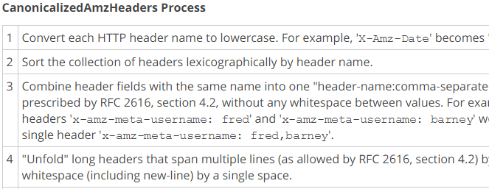
HMAC Drawbacks
Client and server must compute hash exactly same
Notes:
The primary drawback to HMAC is complexity.
* Client and server must compute the hash EXACTLY the same way.
* Usually requires publishing detailed instructions that describe how to “canonicalize” the request data
This image is a tiny piece of just one portion of instructions for canonicalizing an AWS API call.
* Client and server must agree on which headers to include. If middleware network component adds a header to the request, server will calculate different signature.
This complexity is a necessary part of using HMAC. It’s the price you pay for the increased security that signed requests provide.

Slide 27
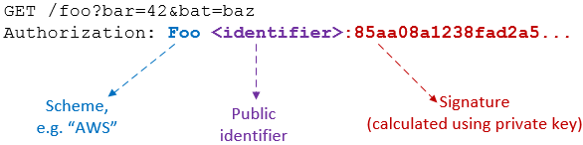
Signed requests using HMAC
Notes:
In order for signing to work, the request must include at least two things:
The signature created with the secret value
An pointer to the identity that created the signature
Identity indicator is required so server knows which secret value to verify with
If you build an HMAC system you’ll have to choose what to use as the identifier and what to use as the secret value.
Internal APIs can use member ID or PK
Public APIs will probably want to use an API Key
In any case, must be something OK to transmit over the wire
If you use the API Key as the public identifier, what do we use as secret value?

Slide 28
HMAC: What to use as “secret value”?
Must be something app can retrieve in clear text
Salted/hashed passwords won’t work
Issue API Keys as a pair: public API Key + private key
Add expiration timeout if necessary
Notes:
Whatever value you choose to use as the secret, it must be stored in plain text or using reversible encryption. App needs it to verify sig.
Can’t use the user’s password. Whole point of secure password storage is to prevent app from knowing actual password.
A popular approach is to issue API Keys as a pair of values
Public API key, that is transmitted over the wire
Private key that is only known by the client and server.
Storing in text means it can be compromised if an attacker gains access to your database. To combat this, implement an expiration policy for your API Keys

Slide 29
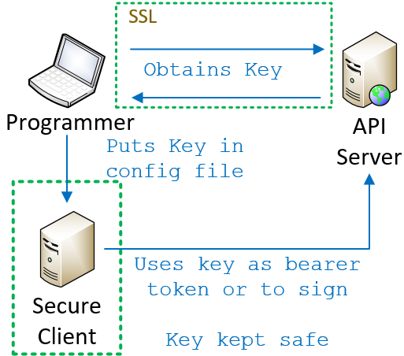
API Keys: Great for server-based clients
Notes:
The last detail of an API Key implementation that you need to think about: how does the client come to know the key in the first place?
Regardless of whether you’re using bearer tokens or HMAC, the client must know the secret value. That knowledge is the key to authentication taking place.
If you’re writing a server-based client it’s easy.
* Programmer obtains the secret value using some secure mechanism * Puts it into the source code or config file for the client.
The client is secure, so as long as you’re either using bearer tokens and TLS or HMAC, the key itself is never exposed.

Slide 30
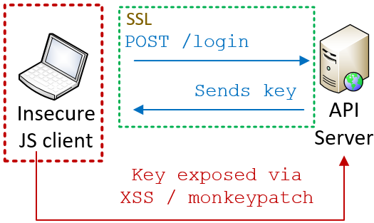
API Keys: Less great for JS clients
Notes:
More complicated for a JS client.
* No way to pre-load the key up front; users can log in from any browser at any time
* Generally speaking, you need the user to actively authenticate themselves by logging in.
* Once authenticated, an API or encryption key could be securely transmitted back to the client, but the client cannot securely store it
* That’s because JS is not a secure environment. Crypto functions can be monkey patched, local storage is susceptible to XSS
* As a rule, you should assume that anything you expose to JS is open for inspection
So if we can’t store the API or encryption keys in JS, how do we secure an API for a JS client?

Slide 31
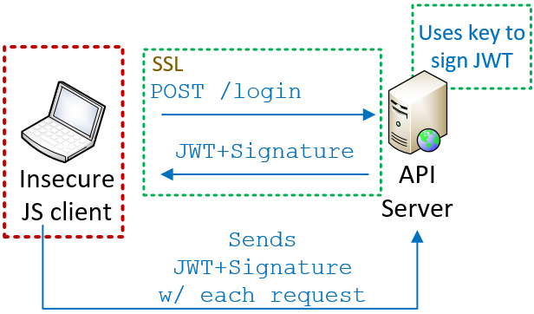
JWT: Secure tokens for JS clients
Notes:
One answer is JSON Web Tokens, pronounced “JOT”
In this approach, the user still needs to securely authenticate themselves by logging in. Once their credentials are validated, the server creates a token indicating that the user has authenticated. The server uses its private encryption key to sign the token and then returns the token and the signature back to the browser.
On each request, browser re-submits token + signature, which server verifies it by re-computing the signature.
This is very similar to HMAC signing the request. If the token and signature match, then the server knows the token is legit and wasn’t modified in transit.
As long as the token itself doesn’t contain any sensitive values, there’s no risk.

Slide 32
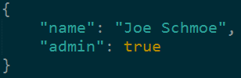
Format of a JWT token
Tokens contain mix of standard & custom “claims”
Tokens are encoded but not encrypted
Tokens are self-contained and stateless
Notes:
From a high level, this is what you need to know about JWT.
It’s a standard for the secure transmission of JSON objects. These objects contain “claims” about the user, which are really just data properties of the JSON object.
Some of those properties are defined by the standard, but you can add custom claims as well. In this example, I’m creating a claim for the user’s name and a claim that they have authenticated as an admin.
This last piece is important. JWT tokens are not encrypted, so they should not contain sensitive values. Instead of sending the user’s API key, and having the server look up the permissions for that key, a JWT token can directly contain the actual permissions.
Instead of a token that says “here’s the user’s ID, go figure out what they can do”, it’s a token that says “here’s what the user can do”.
This makes JWT tokens self-contained and stateless. All the information the API needs to know can be provided as claims, and the token contains everything the server needs to validate the authenticity of those claims.

Slide 33
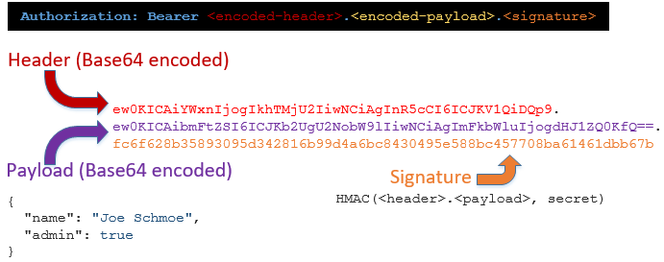
Format of a JWT token
Notes:
The reason the server can trust the claims is because of the signature.
A JWT token is sent over the wire in this format:
A standard header is base 64 encoded
The token payload is base 64 encoded
The encoded header, encoded payload, and secret key are used to create a hash
The encoded header, encoded token, and the hash are concatenated together with dots
When the server receives the token, it decodes the header and payload, re-calculates the hash using its secret key, and compares the result with the hash in the token.
If they match, server knows token was not modified and is authentic.

Slide 34
Storing JWT on the JS client
Don’t put tokens w/ sensitive data into LocalStorage!
 | Safe from XSS? | Safe from CSRF? | App can access token payload?
LocalStorage | ✗ | ✓ | Yes
httpOnly secure cookie | ✓ | ✗ (easy to address) | No
Notes:
Once the server sends your client a JWT token, you need to store it somewhere. Common places are in LocalStorage, or in a cookie.
The advantage of LocalStorage is that your application has access to the data in the token payload. This is useful if the token contains information that you need for purposes other than API authentication. The downside is that information stored in LocalStorage is vulnerable to cross-site scripting attacks, so you should only store tokens there if the payload doesn’t contain anything sensitive.
If you put the token into an httpOnly secure cookie, then the cookie will be protected in transit by TLS, and the token will be completely inaccessible to JavaScript. If you need to put sensitive information directly into the token then this is a good approach, just realize that your JS application code will be completely unable to read the token for anything other than authentication.

Slide 35
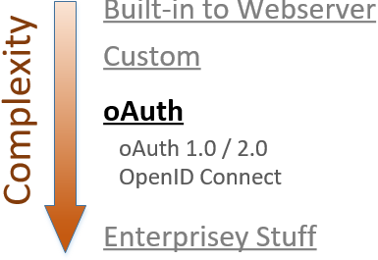
Notes:
At this point we’ve discussed some authentication schemes that are supported natively by the web server itself and we’ve discussed some custom systems based around API Keys. Next on the agenda is Oauth.
OAuth builds on many of the concepts we just saw, but it’s a definite step up in complexity.
We’re going to discuss a few different things: the difference between 2- and 3-party authorization, the differences between OAuth versions 1.0 and 2.0, and what it means for OAuth to be an authorization framework, not an authentication one.

Slide 36

Client/server authentication (2-legged)
Client is resource owner; access its own data
Notes:
OAuth was originally designed to solve the problem of “delegated authorization” in a 3-party scenario.
To explain that, let’s first review the traditional 2-party scenario you see here.
Client uses ITS credentials to access ITS resources on the server. In OAuth parlance, this is a “2-legged” model because there are two entities involved. One scenario that uses this model is server-to-server communication.

Slide 37
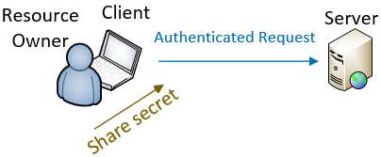
Delegated authorization (3-legged)
Client acts on behalf of the resource owner
Notes:
In other cases, the client is acting ON BEHALF OF of another entity, such as the person using the browser.
In those cases, client is not accessing its own resources but those of the user.
To do this, the user must share their credentials with the client so that the client can use them to make the authenticated request.
That’s fine if you trust the client, and you don’t mind the client impersonating you when it talks to the server.

Slide 38
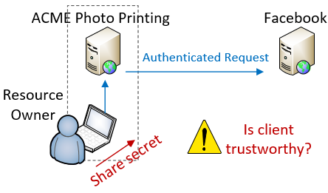
Delegated authorization (3-legged)
Notes:
But what if you DON’T trust the client with your credentials?
Let’s say you have some photos that you’ve uploaded to Facebook and you want to use an online photo printing service to create greeting cards using those photos.
You really don’t want to give ACME your Facebook username and password, but how else does it make the authenticated request on your behalf?

Slide 39
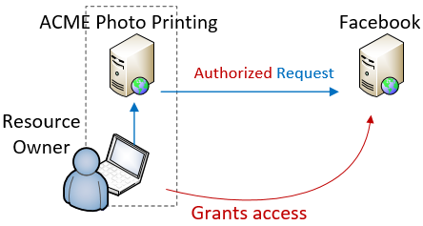
Delegated authorization (3-legged)
Notes:
This is the exact scenario that OAuth was designed for.
“3-legged” model because there are 3 parties involved: the Resource Owner that owns the content, the Service Provider that hosts the content, and the Client that accesses the content.
OAuth allows the Resource Owner to authorize the Client to access the data client on their behalf, but without sharing their actual credentials.
When you do this, ACME is no longer making an AUTHENTICATED request, its making an AUTHORIZED request. We’ll talk about this in a minute.

Slide 40

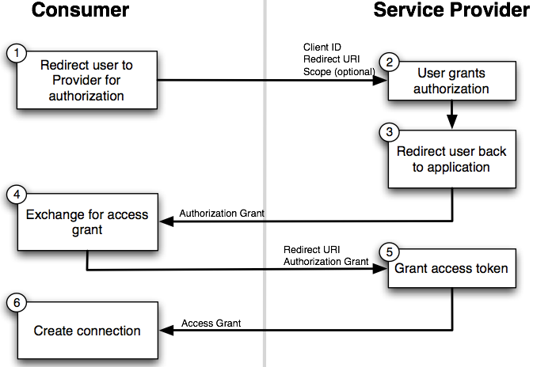
Notes:
Here’s how it works. The user starts out on the client’s website, ACME photos. ACME redirects the user to the provider (Facebook)
The user first authenticates themselves to Facebook
Facebook displays a page to the user to collect authorization, which looks like this

Slide 41
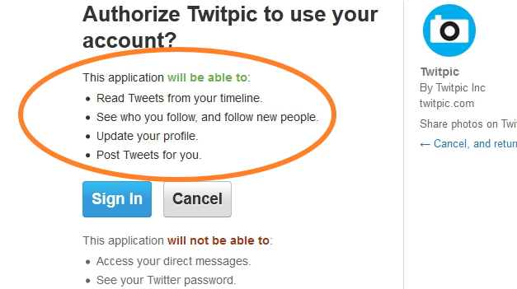
Notes:
This page is hosted by the authorization server, which presumably you trust. It explains the sorts of access that you are authorizing.
If you choose to authorize the access, the OAuth flow continues.

Slide 42
Notes:
User authorizes the access ➔ redirects back to the client with an “authorization grant”.
Client makes another call to service and trades auth grant for an access token
transition
* There are 2 versions of OAuth and they solve this problem in very different ways
* Not universally accepted that the newer version is best

Slide 43
OAuth 1.0a
Uses signed requests (TLS not req. / integrity guaranteed)
3-legged “flow” works best with web-based clients
Complex to implement – use libraries!
Notes:
Published April 2010, 1,0a came out shortly after. When I say “OAuth 1.0” I really mean “1.0a”.
In technical terms, implemented using signed requests.
Does not require TLS
Message integrity is guaranteed
Works best w/ web-based clients b/c user must be sent to a website to do the auth
Primary drawback complexity from signing
Mitigated a little by libraries, but still a lot of work

Slide 44
OAuth 2.0
Not backwards compatible with 1.0/1.0a
No HMAC signatures == simpler to implement
Delegates security entirely to TLS
Better support for enterprise & non-web clients
Notes:
OAuth 2.0 was designed to address those drawbacks. It is an entirely different implementation and the two are not compatible.
Major difference is simplicity
Uses bearer tokens instead of request signing
Requires TLS to keep the tokens safe in transit
OAuth 2.0 also has better support for non-web clients and enterprise use cases.
Provides more “flows” than 1.0
Means there are more supported authentication workflows that can be supported

Slide 45
OAuth 2.0 – drawbacks
OAuth 2.0 is a framework, not a protocol; less interoperable than 1.0a
Notes:
It’s important to note that the 2.0 spec is considered a framework rather than a protocol.
In order to support the wider range of authorization workflows, many decisions are left to implementers
This hurts interoperability.
Two providers may say they are OAuth 2 compliant, and have very different actual implementations
Code you write for one provider may require a lot of work to support a different provider

Slide 46
OAuth 2.0 – drawbacks
OAuth 2.0 and the road to Hell
“When compared with OAuth 1.0, the 2.0 specification is more complex, less interoperable, less useful, more incomplete and, most importantly, less secure.”
Eran Hammer, former lead author of OAuth working group
http://hueniverse.com/2012/07/26/oauth-2-0-and-the-road-to-hell/
Notes:
There’s some controversy around 2.0 as well.
Eran Hammer was the lead author for the OAuth working group
withdrew his name from the 2.0 specification prior to publishing
“OAuth 2.0 and the Road to Hell”

Slide 47
Use OAuth 2.0 if…
OAuth 2.0 and the road to Hell
“If you consider yourself a security expert, use 2.0 after careful examination of its features. If you are not an expert, copy an implementation of a provider you trust… or make sure you have some security experts on site to figure it out for you.”
Eran Hammer, former lead author of OAuth working group
http://hueniverse.com/2012/07/26/oauth-2-0-and-the-road-to-hell/
Notes:
He goes on to say “If you consider yourself a security expert, use 2.0 after careful examination of its features. If you are not an expert, copy the implementation of a provider you trust to get it right or make sure you have some security experts on site to figure it out for you”.
This might just be sour grapes or a difference in vision for OAuth.
Make sure you research before choosing OAuth 2

Slide 48
OAuth is not an authentication protocol!
Notes:
Let’s talk about authentication vs authorization again.
OAuth is a standard for delegating authorization to an API.
About you, as a Resource Owner, authorizing one application to access your data from another application.
It is not an authentication protocol and should not be used as one, for two reasons.

Slide 49
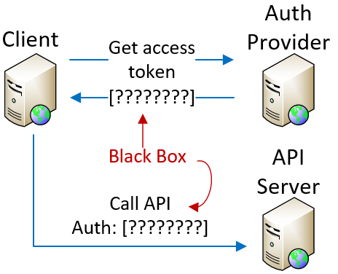
Access tokens are opaque - don’t provide ID
Notes:
First, whole point of authentication is to securely assign an identity to a request.
OAuth access tokens don’t tell the client anything about user identity.
By definition, access tokens are opaque to the client.
Client gets token from auth provider
Client uses token to make API calls
Token itself is a black box – client can’t parse it or extract data
Therefore, the access token alone cannot tell us WHO is making the request, and there is no authentication without a “who”

Slide 50
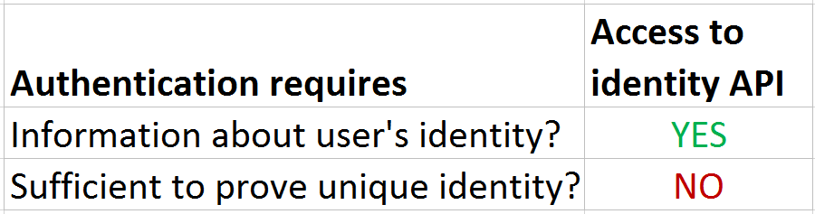
Access to identity API != authentication
Notes:
But what if the access token authorizes you to call an API that will provide user identity information?
If you have a token, & token authorized to obtain identity information, is that sufficient for authentication?
NO, because no guarantee that only that user was able to authorize that access. If more than one entity can delegate access to that identity API, then you can’t assume that your authorization is sufficient for authentication
This might be easier to understand with an example.

Slide 51
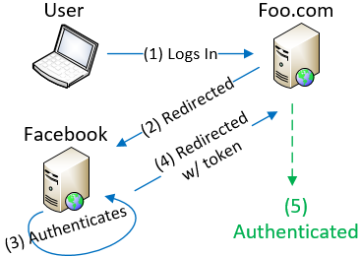
Access tokens lack audience restrictions
Notes:
Let’s say there is a website that lets people “log in with Facebook”.
I go to Foo.com and follow normal OAuth flow and authenticate against Facebook,
I authorize Foo.com to access my data and get redirected back to Foo.com with an access token.
Foo.com uses token to make an API call to Facebook’s API, gets my data, and logs me in.
I have given Foo access to my profile and in exchange, Foo gives me access to my account on their system
In this scenario, Foo would be correct in considering me an authenticated user.

Slide 52
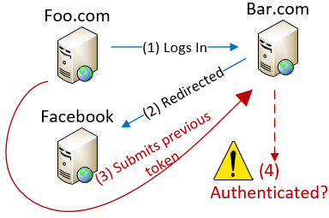
Access tokens lack audience restrictions
Notes:
Let’s say Foo.com isn’t trustworthy. It turns around and makes a login request against Bar.com, which also allows Facebook logins.
Instead of going through Auth process, Foo resubmits the access token they obtained from my authorization
Bar uses that access token to call Facebook’s API and is given my data
Bar then assumes that Foo has authenticated as me, so Foo is logged in and given access to my account with BAR
Neither Foo nor Bar have more access to FB data than was authorized
Foo has impersonated me at BAR and can access Bar’s data associated with my account
Possible because OAuth access tokens do not have audience restriction. This is a problem with bearer tokens, Bar doesn’t know that the access token is being misused.

Slide 53
Access token != authentication
DO NOT use resource authorization as proof of authentication
Notes:
To avoid that problem, ONLY use access tokens to access the authorized resource.
If you use possession of an access token as proof of authentication, you are vulnerable.
To solve this problem, the access token would need to
assert which client it was granted to and
which authenticated identity authorized it
That way, only that one authorized client would be able to use the token, and the token itself would be proof of identity

Slide 54
OpenID Connect
Open standard, built on top of OAuth 2.0
ID Tokens – gives authentication data to client
Audience restrictions
Enables authentication against 3rd party identity providers
Notes:
That’s the basic concept behind OpenID Connect.
Open standard that defines an interoperable identity layer on top of OAuth 2.0.
Allows authentication against 3rd party identity providers by closing some of the gaps we just mentioned.
ID Connect adds extra tokens which are given to client in addition to regular OAuth access token.
These have well-known format so the client can extract identity claims and audience restrictions directly from the token.
OpenID Connect replaces OpenID 2.0 and is the best way to implement something like “Log in with Google” on your app.

Slide 55
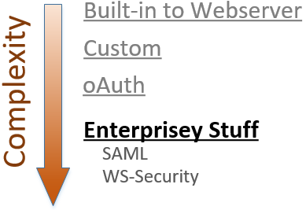
Notes:
To wrap up our list I want to briefly mention two additional technologies that are used in large enterprise scenarios.
The first is SAML, which stands for “Security Assertion Markup Language”. It’s an “XML-based data format for exchanging authentication and authorization data between parties”. SAML is commonly used in enterprise SSO scenarios.
The second is WS-Security. This is the king of complexity and deals with things such as “messaging across trust domains”. God help you if that’s a use case your API cares about!

Slide 56
So what should you use?
Notes:
So what should you use?
I just threw a ton of choices at you, and as usual the correct answer is “it depends”.
Let’s briefly recap those options and talk about the ideal use cases for each.

Slide 57
Choose your own adventure
Consider client certificates if…
You’re using IIS + Active Directory (or equivalent) to secure a private API on trusted network, or
You want server-to-server authentication w/out passwords
Notes:
Client certs are useful if you can get users to install them
Bad choice for public API
Work best for securing private API on trusted network.
In Windows land, the sweet spot is when using IIS and Active Directory, because the tooling to link certs to identities already exists.
Also a good fit for server to server auth because you don’t have to manage passwords

Slide 58
Choose your own adventure
Consider HTTP Basic Auth if…
You want to write as little code as possible, and
You can tolerate TLS on all requests
Good for server-to-server API calls
Notes:
Basic Auth is ideal if
You want to write very little code, and
You’re comfortable relying on TLS to keep passwords safe over the wire
An ideal use case is server to server API calls where you can’t use client certs.
Not ideal for pure JS clients b/c it requires storing the credentials somewhere in browser memory.

Slide 59
Choose your own adventure
Consider HTTP Digest Auth if…
Don’t. Just don’t.
Notes:
There’s no good reason to use Digest Auth.
If you can tolerate TLS on all requests then just use Basic Auth. If you can’t, use signed requests or JWT.

Slide 60
Choose your own adventure
Consider custom API Keys as bearer tokens if…
You own the client AND the API, and
You can require TLS, and
You value simplicity over security
Notes:
You can use API keys as “bearer tokens”, where you pass the key itself with every request, when
You own both client and API
You prefer the simplicity of bearer tokens over signing
Slight risk: keys only as safe as TLS implementation.

Slide 61
Choose your own adventure
Consider custom API Keys and signed requests if…
You own the client AND the API, and
You can’t/don’t want to rely on TLS
Notes:
If your own client AND API and you want more security than passing them as bearer tokens, then consider using signed requests.
Remember that creating the signature can be complex
client and server must do it in the same way
3rd party client support means you’ll need to document and support canonicalization process
Good for server to server API calls where you need extra security

Slide 62
Choose your own adventure
Consider JSON Web Tokens if…
You’re writing a JS client for your own app (i.e. a SPA)
Not a good fit for automated, server-to-server interaction
Notes:
If you’re writing a JS client for your own application, such as the front-end of a SPA, then JWT might be a good fit.
Remember that this does require a secure login with user-entered credentials to initialize the token. If you need to support server-to-server interaction then this probably won’t work for you.

Slide 63
Choose your own adventure
Consider OAuth 1.0a if…
You’re supporting 3rd party clients, and
You’re writing a web-based app, and
You can’t/don’t want to require TLS, and/or
You care about client/provider interoperability
Notes:
If your API will support 3rd party clients then OAuth is worth a loo.
Consider version 1 if
You’re writing a web-based app, and
You can’t or don’t want to rely on TLS for security
You might also consider version 1.0a if you care about client/provider interoperability and want to support clients that can connect to multiple API providers with just a few config changes
The primary drawbacks with OAuth 1.0 are
complexity involved in making signed requests
limited support for non-browser clients

Slide 64
Choose your own adventure
Consider OAuth 2.0 if…
You want to avoid complexity of signed requests, and
You can require TLS on all requests, or
You need to support a wider set of devices and “flows”
Notes:
If you care more about flexibility and simplicity than interoperability and security, and you can require TLS on all requests, then OAuth 2 is better than 1.
2.0 is also better if you want to support a wider set of devices and flows.
Just remember that code you write for one OAuth 2 provider may require significant changes to support a different provider.

Slide 65
Choose your own adventure
Consider OAuth 2.0 + OpenID Connect if…
You need to authenticate against 3rd party identity data
You want to centralize your own authentication and identity systems
You want SSO without SAML
Notes:
Remember that OAuth by itself is for authorization only.
If you want to authenticate against 3rd party data then use OpenID Connect on top of OAuth 2.0. This will let your users authenticate to your API with their Google accounts, for example.
You can also use OpenID Connect if you have multiple internal systems and you want to set up your own centralized Identity and authentication provider.

Slide 66
Choose your own adventure
Consider SAML or WS-Security if…
You suffer endlessly in Enterprise Hell, or
You find XML to be life-affirming and joyful
Notes:
Lastly, you should use SAML or WS-Security if you literally have no other choice, and/or have a sick love affair with XML.
If you choose either of these, good luck but don’t ask me if you have questions.

Slide 67
3 key things to remember
Requests must use TLS, or be signed
For server-based clients, use Basic Auth or API Keys. For JS clients, use JWT.
OAuth is for authorization, not authentication. Use OpenID Connect if you need both
Notes:
Research shows that attendees of a talk such as this will generally remember only 3 things. That means that most of the information I just shared with you will vanish quickly if you don’t act on it.
So here are the 3 most important things I want you to remember:
Requests must use EITHER TLS, OR be signed. If you’re passing sensitive data over the wire then use TLS. If you want to verify message integrity, use signing
For server-based clients, you can use Basic Auth or API Keys, depending on how much flexibility you need. Use JWT for JS clients.
OAuth is for authorization, not authentication. Use OpenID Connect if you need both.

Slide 68
That’s all, folks!
Materials
www.petry-johnson.com
github.com/spetryjohnson
Contact
@spetryjohnson
seth@petry-johnson.com
Notes:
Actually, you all look like smart people, so I want you to try really hard to remember a 4th thing, and that’s my website. From there you can get to my Github where these slides are kept and you can also get to my email, my Twitter, my LinkedIn, etc.
Please feel free to reach out with feedback, questions, comments, etc. I’d love to hear from you.
THANK YOU!

